Slide 1
Final Project
INFSCI 2560
Group Name: Lamborghini
Group Member:
Chengzhuo Xiong CHX53
Yutong Tang YUT89 Sizhe Fu SIF33
Shiyuan Luo SHL298

Slide 2
CONTENT
Introduction(Y.Tang)
Features & Functionalities (Y.Tang)
Technologies (C.Xiong)
Challenges (C.Xiong)
Roles / Contributions (C.Xiong)

Slide 3
Introduction

Slide 4
Introduction
Simple E-Commercial website
Built with MERN stack (MongoDB, Express, React, NodeJS)
With general online shopping website features
Contains products with several different categories (Accessories, Desktops, Laptops, Phones, Tablets, Watches, Vehicles, Clothes, Toys, Decorations)
Guests can Browse/Select different products
Register as users to add them into shopping cart
Administrators are able to manage all the products & users

Slide 5
Features & Functionalities
Guests
General Users
Administrators

Slide 6
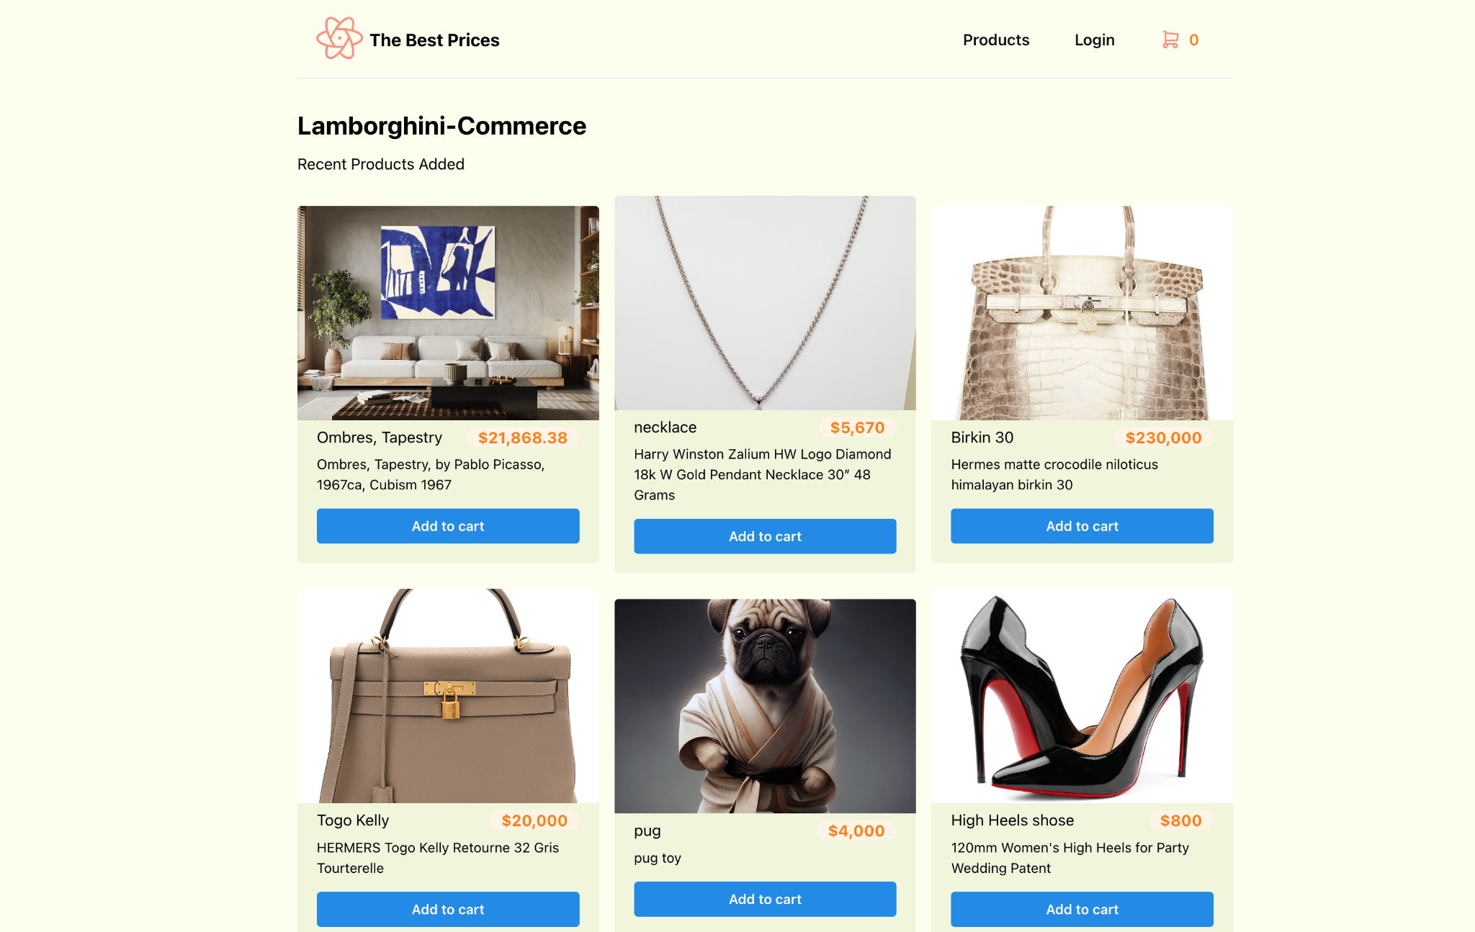
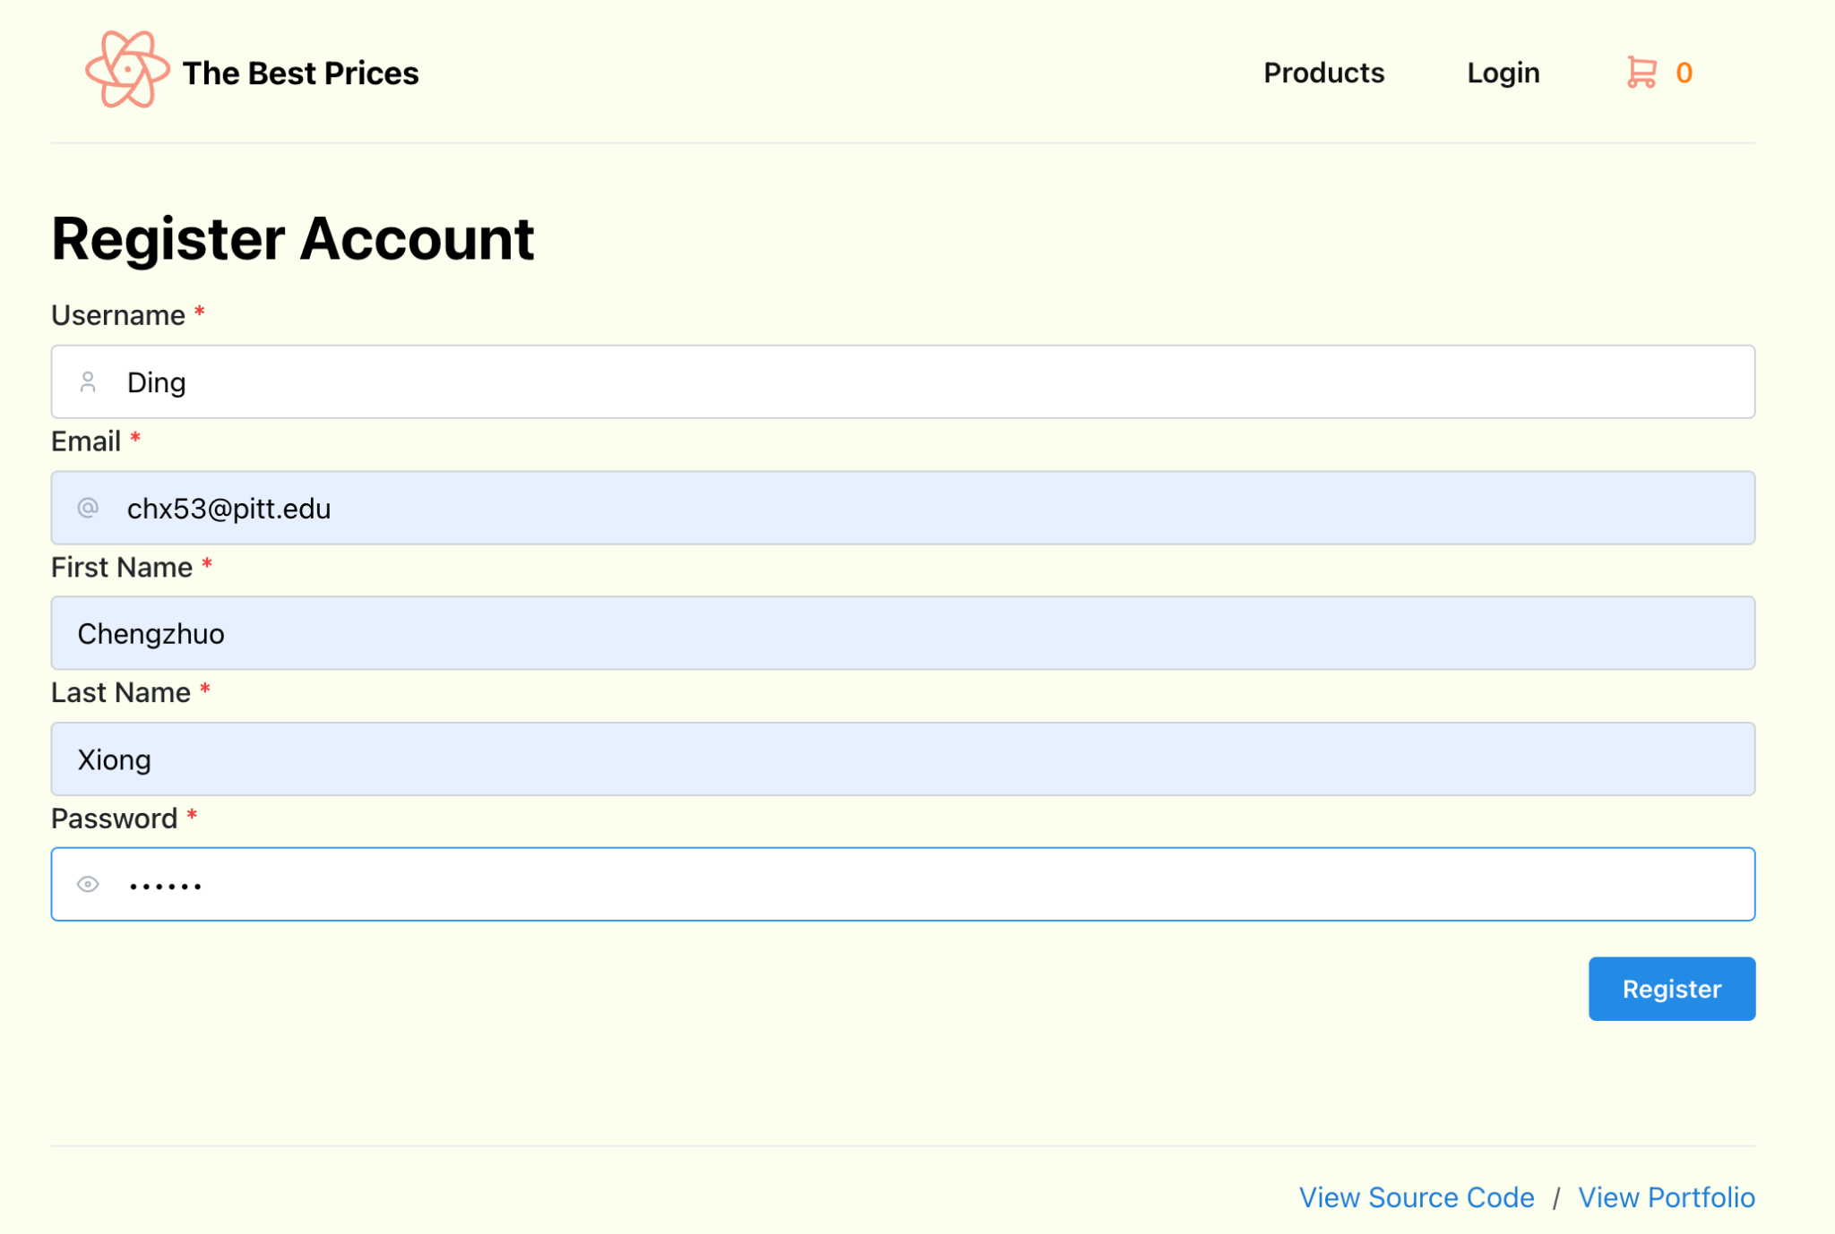
Guests
Browse the recently added products
Register as a user

Slide 7
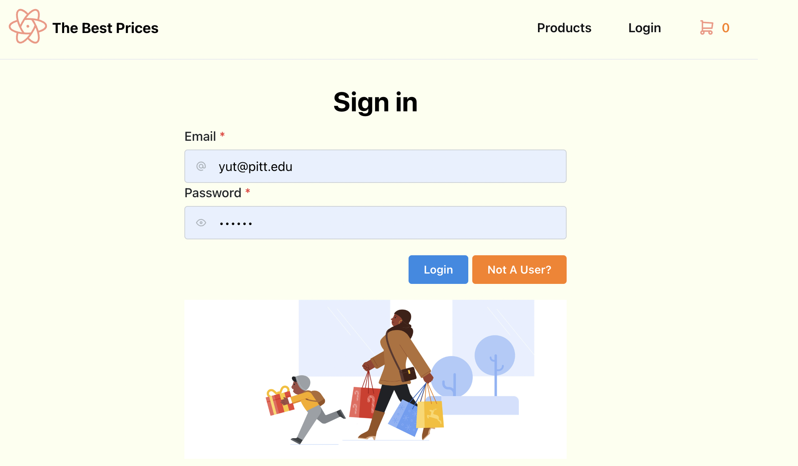
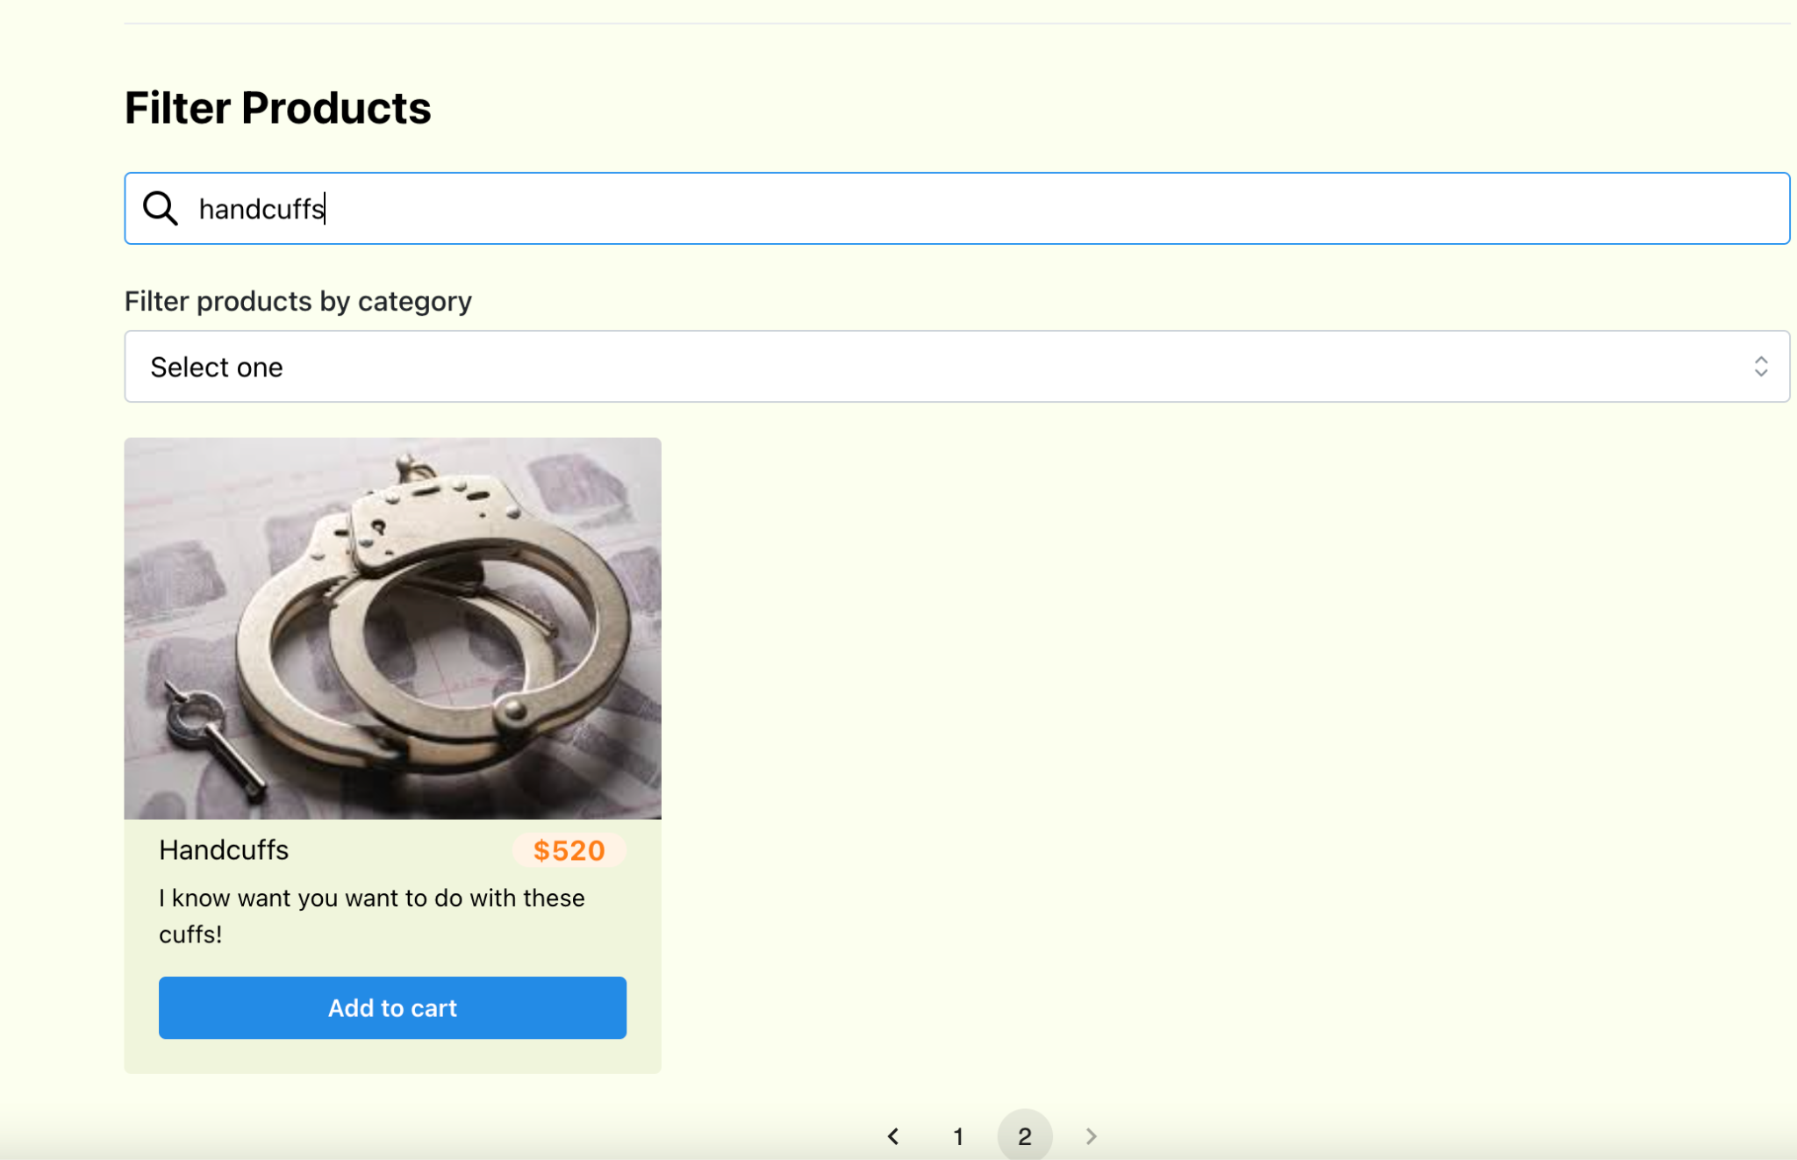
Users
Log In
Filter Products By its name/category

Slide 8
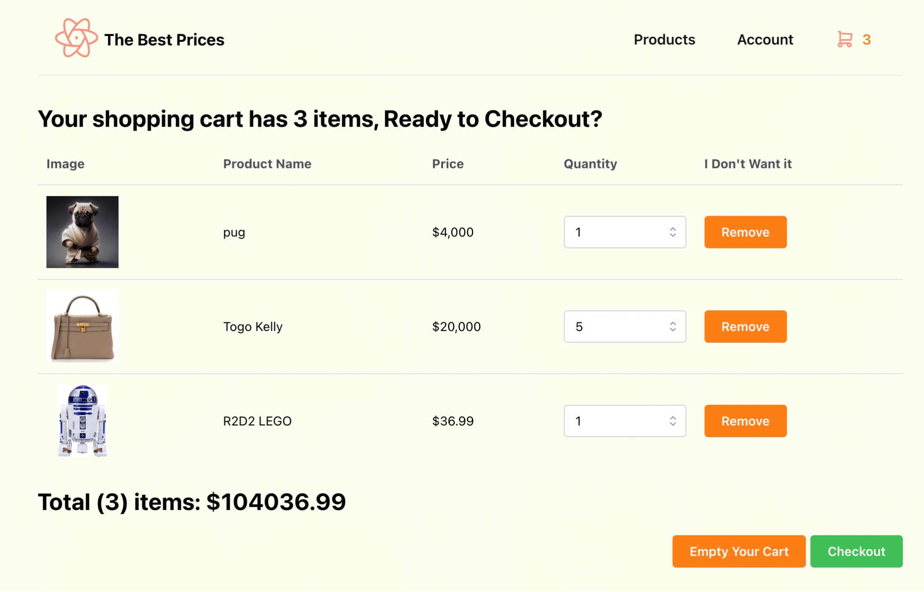
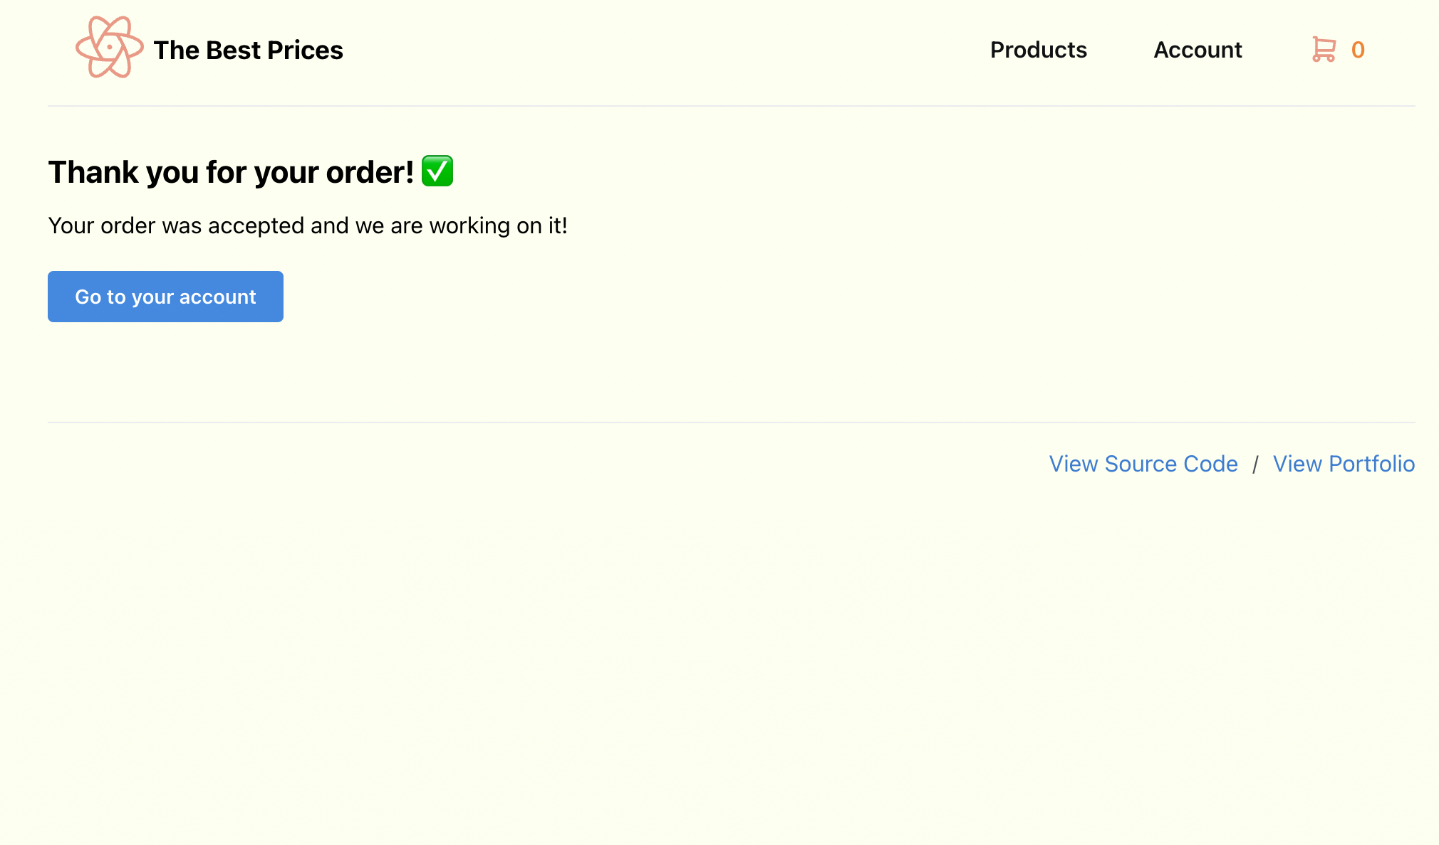
Users
Add Products into Shopping Cart
View/Edit shopping cart & Place order

Slide 9
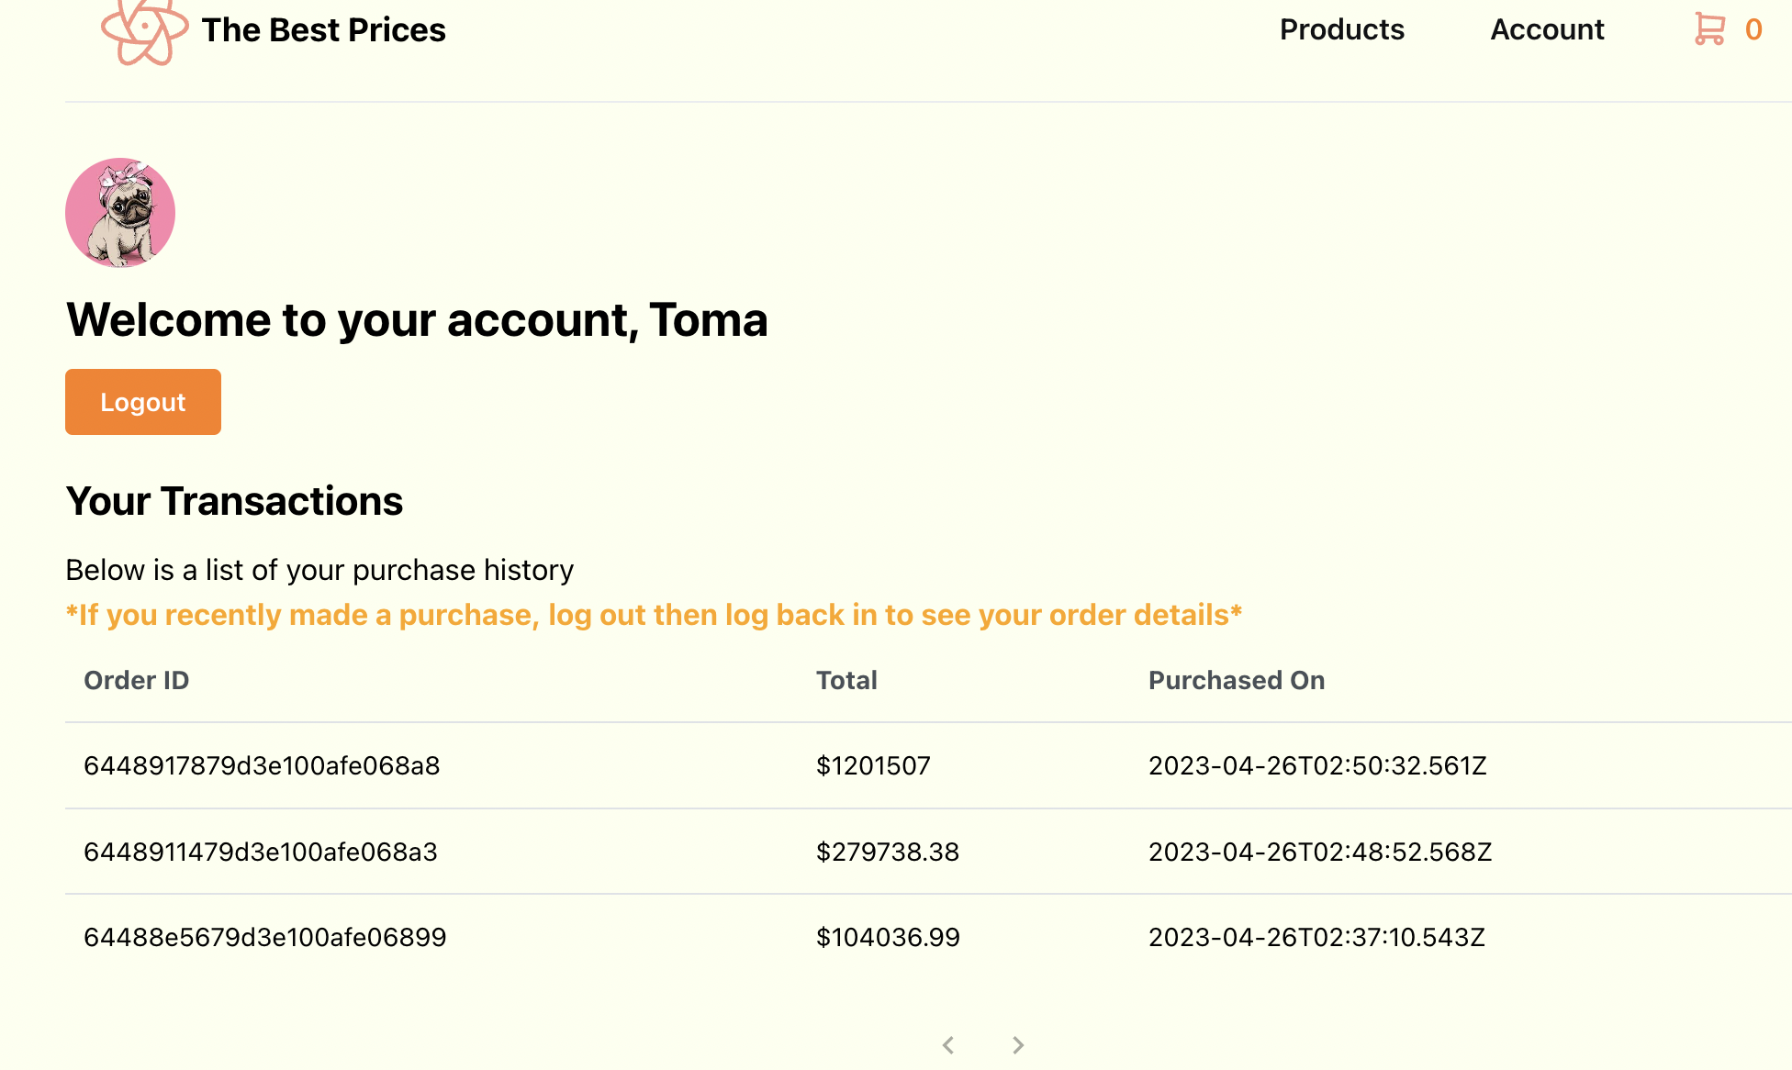
Users
View profile & transactions

Slide 10
Function Display
(Guests & Users)

Slide 11
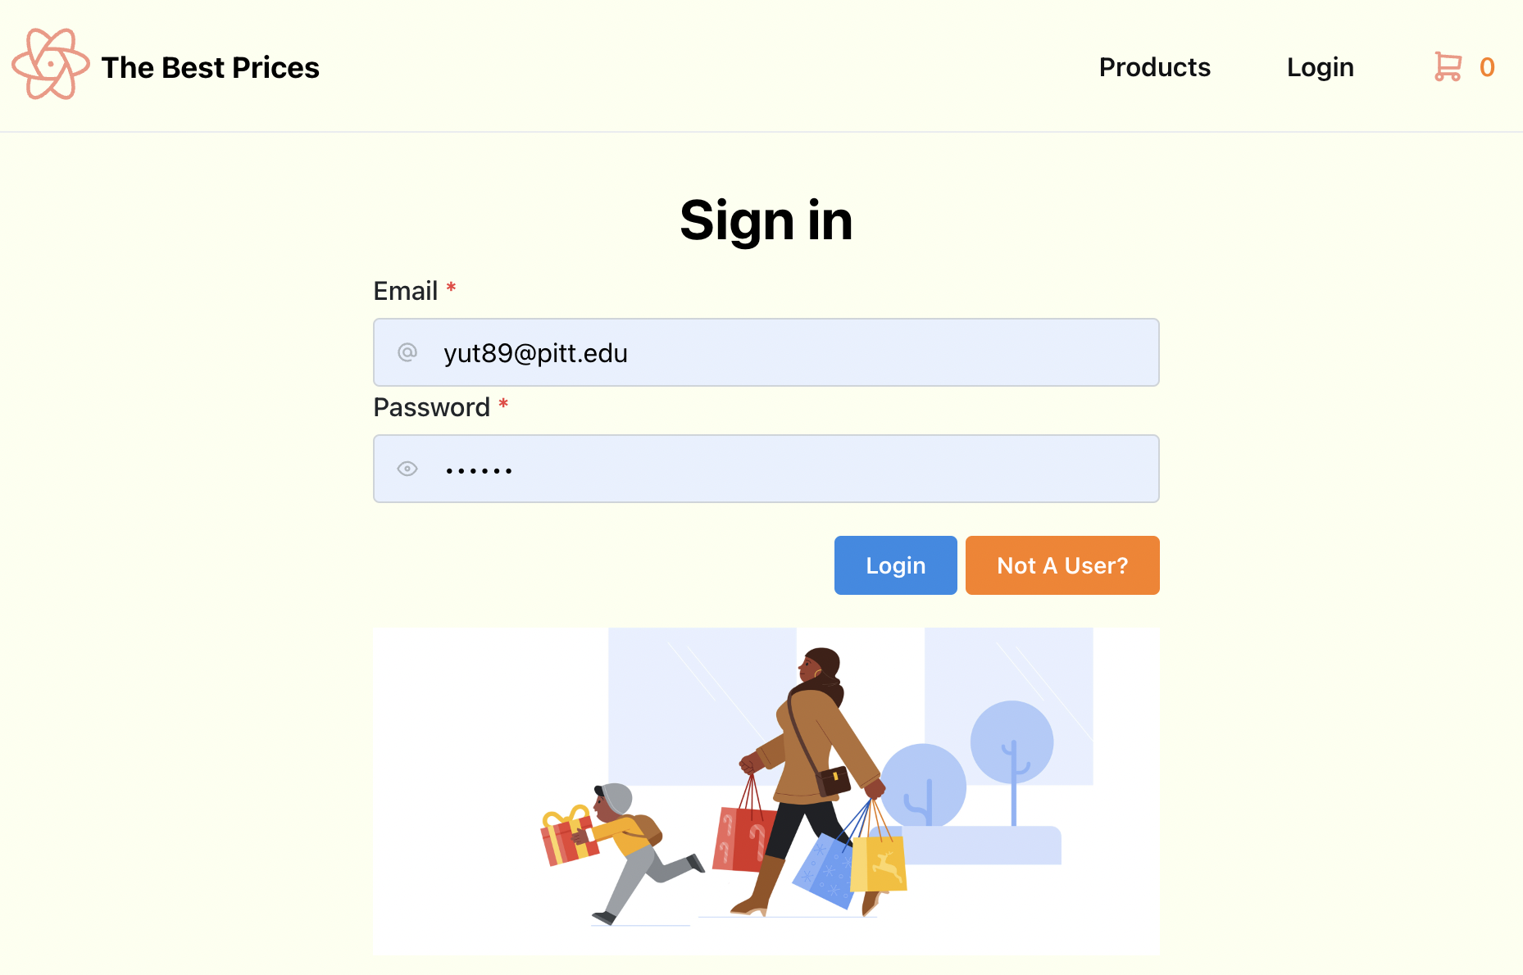
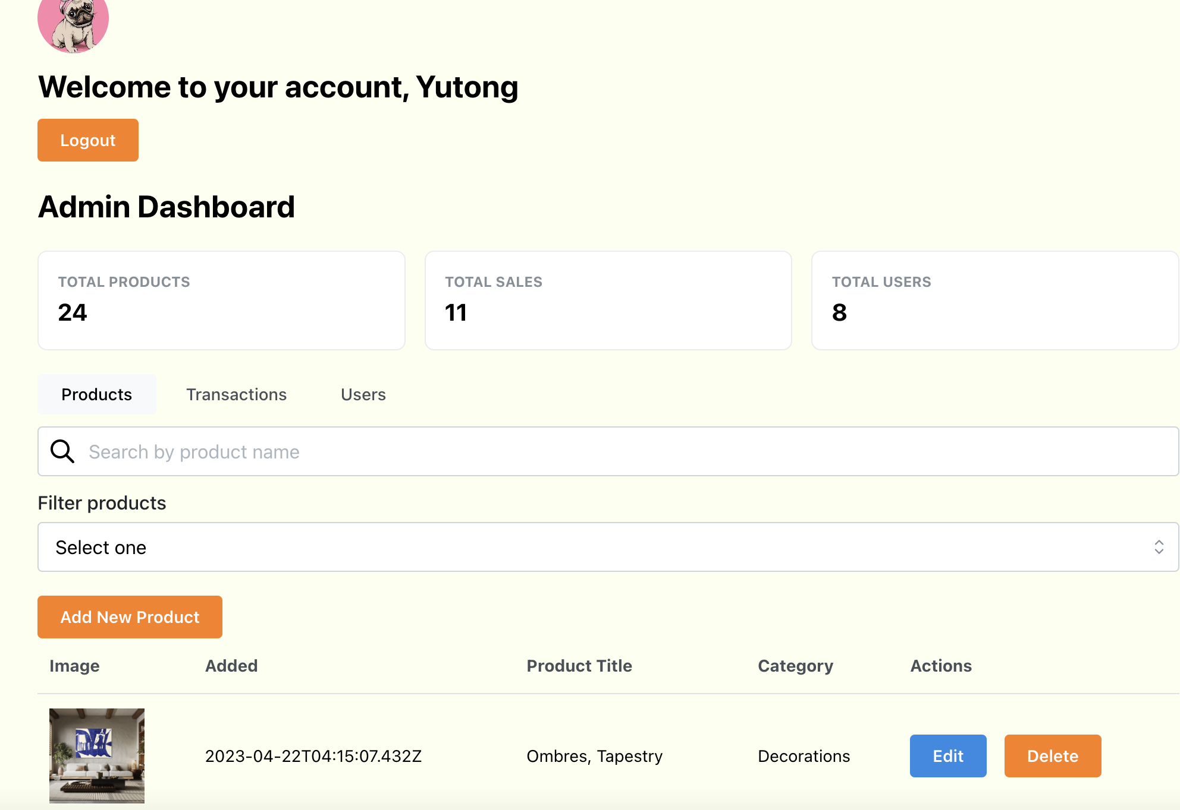
Administrators
Log In
View Profile

Slide 12
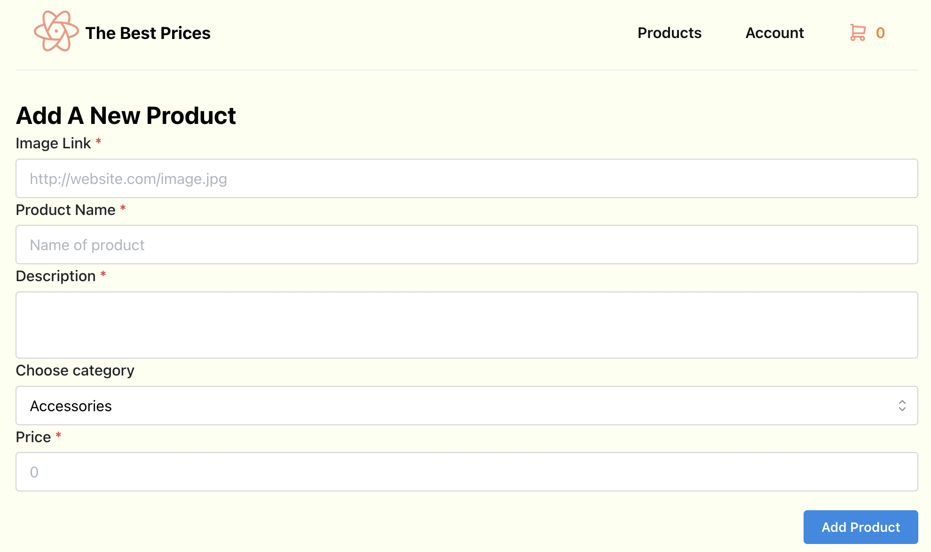
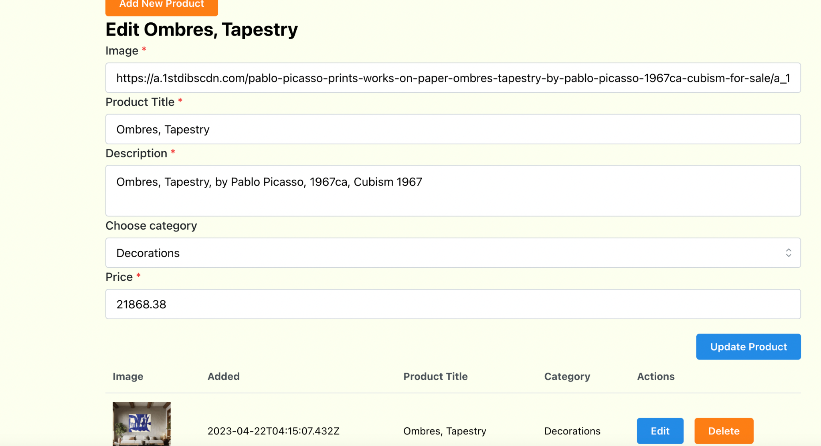
Administrators
Add new products
Edit/Delete Products

Slide 13
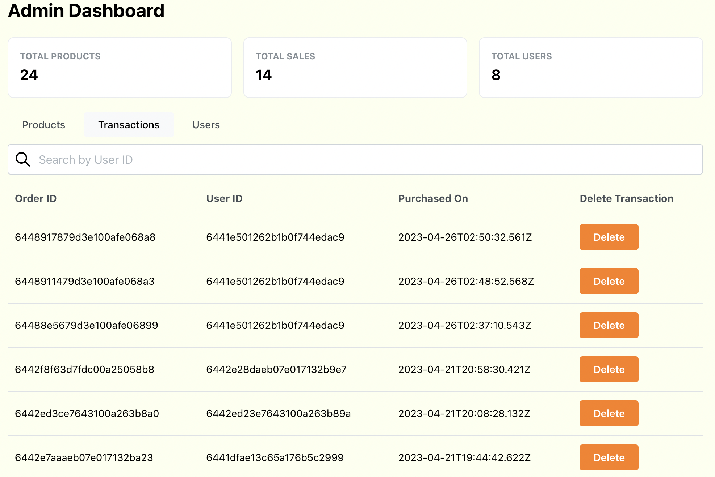
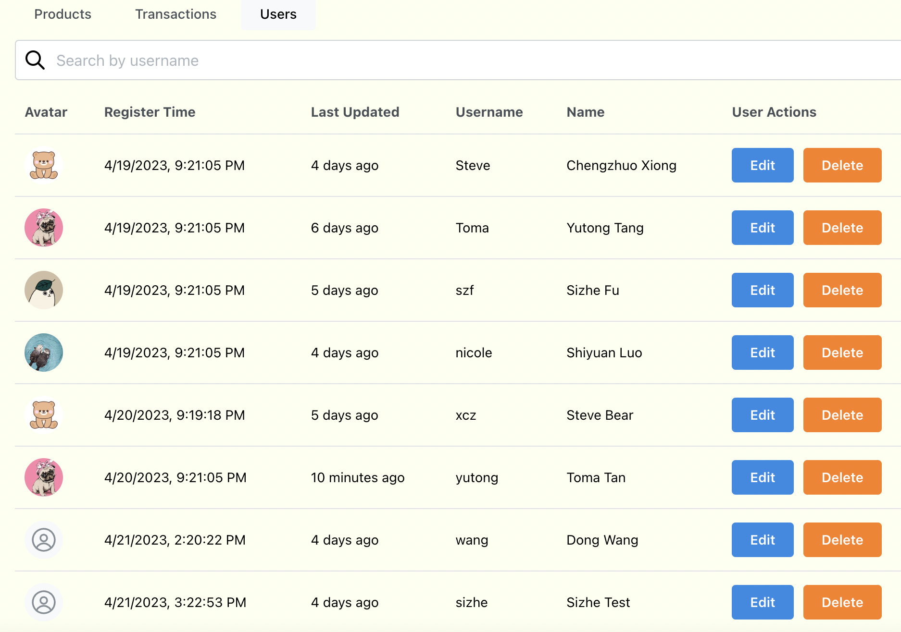
Administrators
View all the transactions
View all the Users

Slide 14
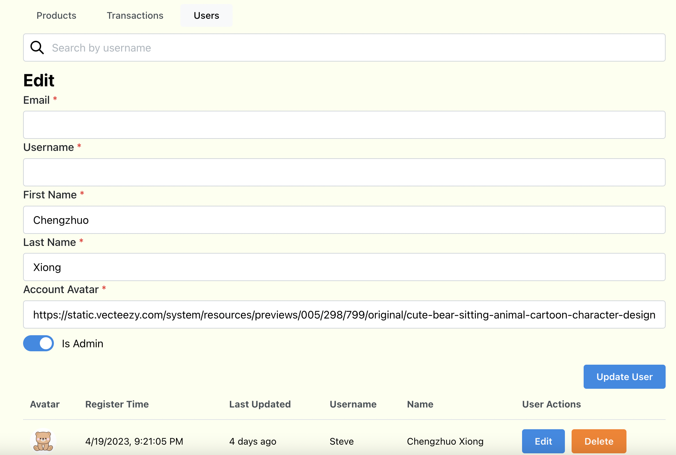
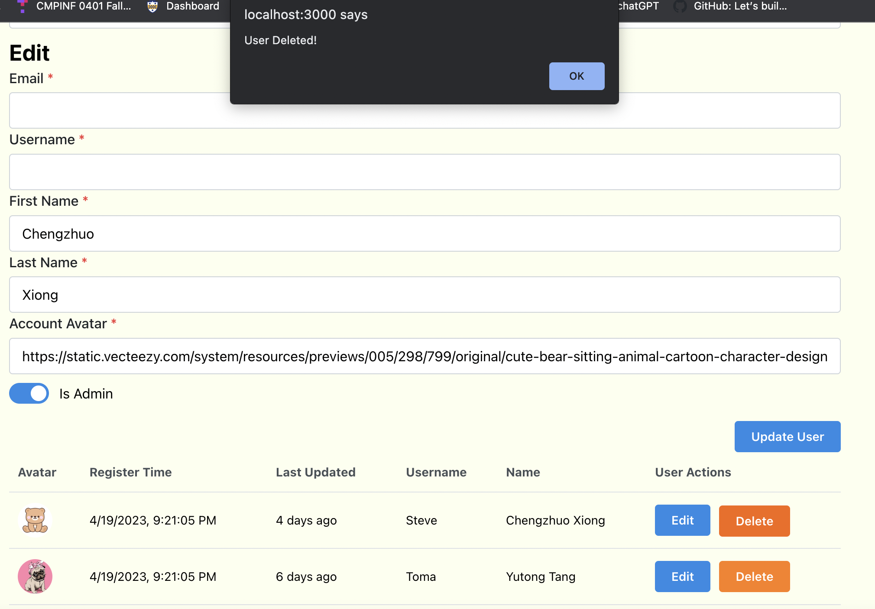
Administrators
Edit the data for every users
Delete Users

Slide 15
Function Display
(Administrators)

Slide 16
Technologies
(MERN Stack)

Slide 17
Front-End
react: A popular JavaScript library for building user interfaces, with features such as a declarative programming model, component-based architecture, and support for server-side rendering.
cors: A Node.js package that provides middleware for handling Cross-Origin Resource Sharing (CORS) requests, allowing web pages to access resources from other domains.
date-fns: A lightweight and modular JavaScript library for parsing, manipulating, and formatting dates.
axios: Promise-based HTTP client, handling request and response interceptors, automatic request cancellation, and support for common data formats such as JSON and FormData.

Slide 18
Front-End
react-router-dom: A package that provides declarative routing for React applications, allowing users to navigate between different views and pages without a full page refresh.
react-scripts: A set of scripts and configuration files that are used by Create React App, a popular tool for quickly setting up and developing React applications.
tabler-icons-react: A library of over 1400 free and open-source SVG icons that can be used in React applications.
web-vitals: A library for measuring and reporting essential web performance metrics, such as the time it takes for a page to load and become interactive, with support for different types of devices and network conditions.
Mantine UI: React component library that provides a set of customizable and accessible UI components, including buttons, forms, modals, and more, with support for theming and customization.

Slide 19
Back-End
Express: Fast and minimalist web framework for Node.js used for building web applications and APIs.
Mongoose: MongoDB object modeling tool designed to work in an asynchronous environment that provides a schema-based solution to model data.
Body-parser: Middleware that extracts the entire body portion of an incoming request and exposes it on req.body.
ejs: Generate HTML markup with plain JavaScript.
cors: Middleware for handling Cross-Origin Resource Sharing (CORS) that allows a server to specify who can access its resources.

Slide 20
Back-End
Secured Password
AES algorithm of the dependency ‘crypto-js’ is applied in our app.
It encrypts the passwords into a string of characters, from which the original password is unlikely to be retrieved.
Json web token authentication
‘jsonwebtoken’ can not only verify the status of the users but also let users log in for a period of time without filling the log-in information again.

Slide 21
Challenges

Slide 22
Challenges
Back-End:
Secured Password (‘crypto-js’, AES algorithm)
Json web token authentication (‘jsonwebtoken’)
Different functionality for general users and administrators
Front-End
Unify the styles of different pages
Guarantee the user experience(easy to use and intuitive)
Integration with back-end

Slide 23
Roles & Contributions

Slide 24
Roles & Contributions
Group Name: Lamborghini
Name | Role | Contribution
Chengzhuo Xiong | Project Manager & Back-end Developer | 1. Developed the APIs for authentication and users 2. Established the web tokens for user verification 3. Debug the whole project code 4. Participated for making the slides (Introduction & Features)
Yutong Tang | Project Designer & Back-end Developer | 1. Established the data models for products/transactions/users 2. Developed the APIs for products and transactions 3. Participated for making the slides (Technologies & Challenges)
Shiyuan Luo | Project Designer & Front-end Developer | 1. Created the website's structure, styling, and interactivity 2. Integrated front-end components with the website's back-end systems 3. Wrote the project report
Sizhe Fu | Project Designer & Front-end Developer | 1. Created the website's structure, styling, and interactivity 2. Worked for responsive design 3. Integrated front-end components with the website's back-end systems

Slide 25
Thanks!
Group: Lamborghini
Date: 04/27/2023

